Slide 1

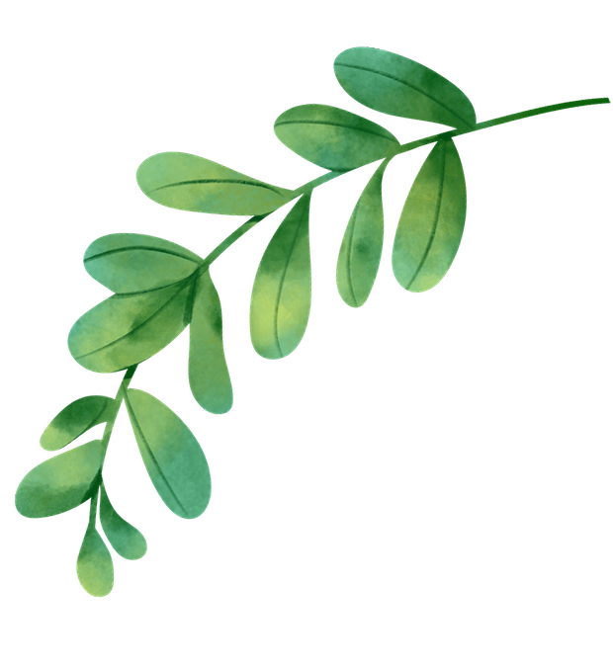
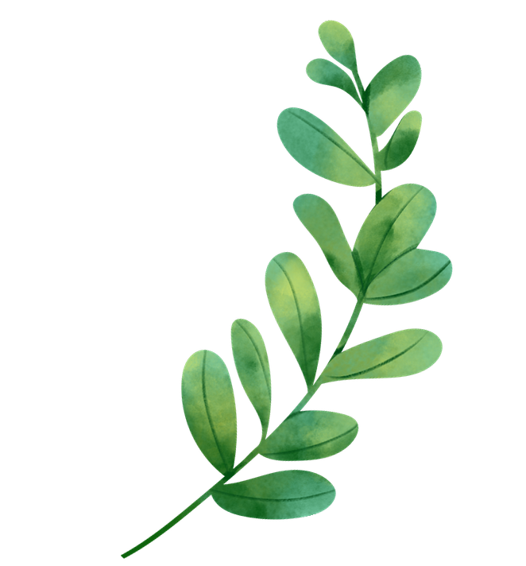
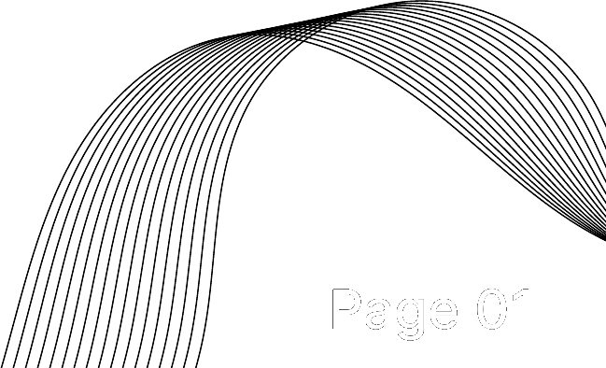
ASSIGNMENT NO. 2
COMPARATIVE STUDY AND IMPLEMENTATION OF GENERATIVE AI MODELS
Image Reconstruction and Image Generation
NAME :- PARTH KITCHLOO PRN :- 202401110014
NAME :- RAGAV SHARMA PRN :- 202401110012
NAME :- GUFRAN SHAH PRN :- 202401110011
NAME :- SANDEEP KOTWAL PRN :- 202401110052
BRANCH :- AIML BATCH :- A2
Page 01

Slide 2
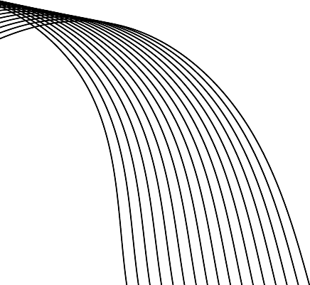
INTRODUCTION & MODELS STUDIED
Generative AI learns patterns from data to rebuild or create images. Here we compare two ways of working: reconstructing an input image, and generating a new one.
IMAGE RECONSTRUCTION
IMAGE GENERATION
Autoencoder (AE)
Variational Autoencoder (VAE)
DCGAN
Stable Diffusion (pretrained)
An encoder squeezes the image into a small latent code; a decoder rebuilds the image. Trained to minimise MSE.
The encoder predicts a mean and variance; a sampled latent z is decoded. Loss = reconstruction + KL divergence.
A generator turns random noise into images while a discriminator learns to tell real from fake.
A pretrained latent diffusion model removes noise step by step, guided by a text prompt.
Image → Encoder → z → Decoder → Image
Image → μ, σ → sample z → Decoder
Noise → Generator → Fake image ⇄ Discriminator
Prompt → Text encoder → Denoising → Image
AE, VAE and DCGAN use MNIST digits; Stable Diffusion generates images from text prompts.
Page 02

Slide 3
IMPLEMENTATION & EXPERIMENTAL SETUP
Environment
Google Colab notebook, NVIDIA Tesla T4 GPU (CUDA)
Python 3.13.16, PyTorch 2.11.0+cu130, torchvision 0.26.0+cu130
Random seed 42 for repeatable runs
Data and models
MNIST subset: 12,000 train / 2,000 test images
AE, VAE, DCGAN: 10 epochs each, batch size 128
Latent size: AE 32, VAE 16; DCGAN noise 64
Stable Diffusion v1.5: pretrained, not trained here; 20 steps, guidance 7.0, 512 × 512
DIFFERENT INPUTS AND OUTPUTS
AE
VAE
DCGAN
Stable Diffusion
MNIST image → AE → reconstructed digit
MNIST image → VAE → reconstruction; random z → new digits
Random noise → generator → digit-like image
Text prompt → pretrained pipeline → 512 × 512 image
Page 03

Slide 4
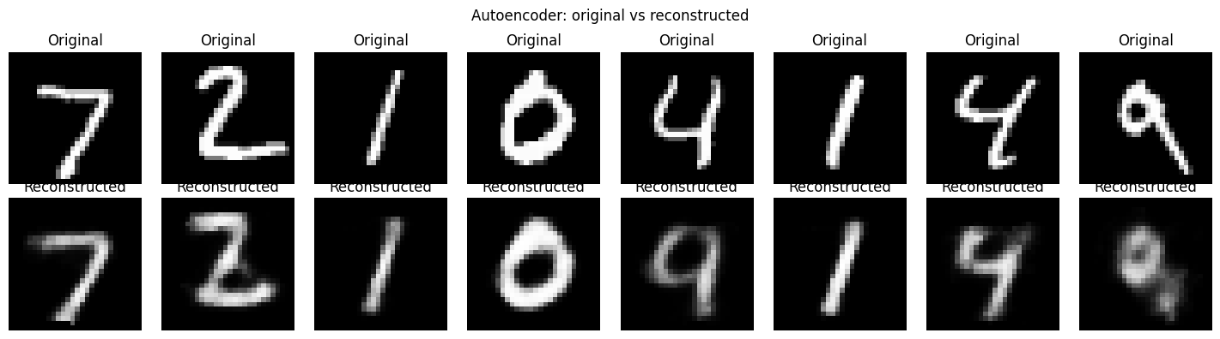
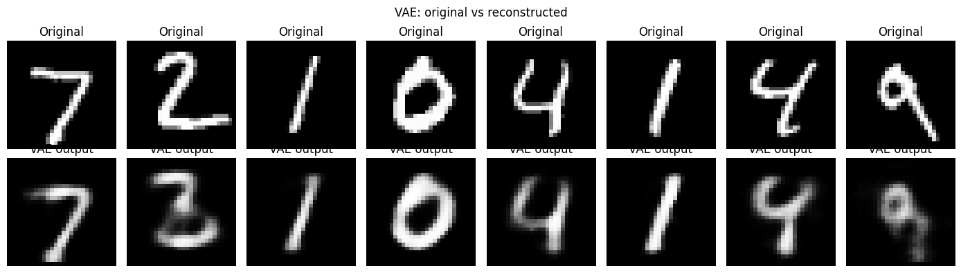
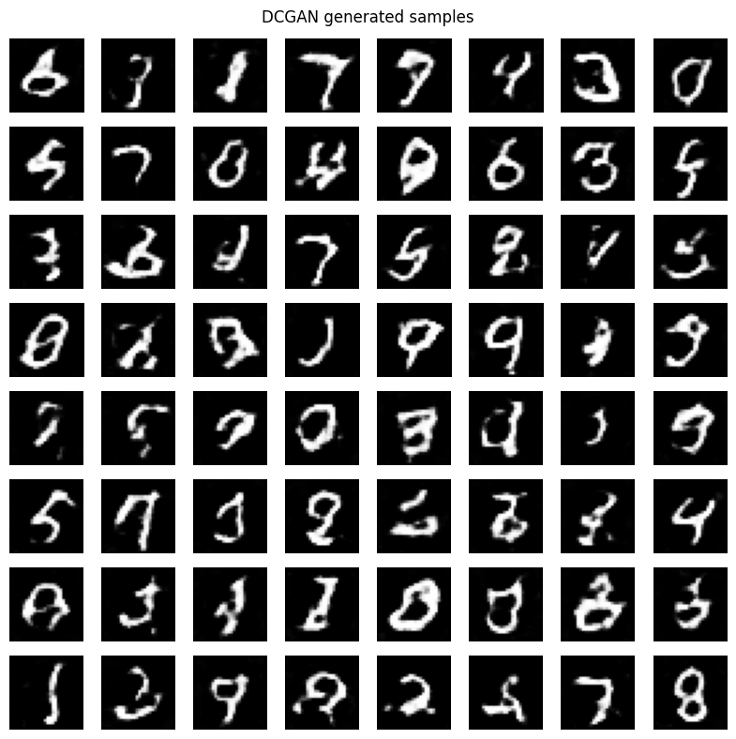
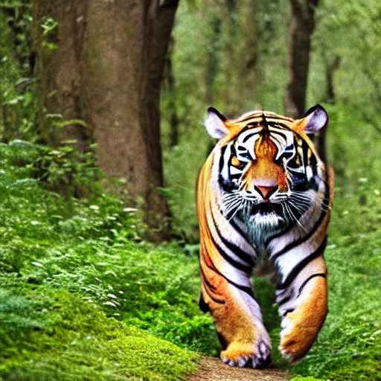
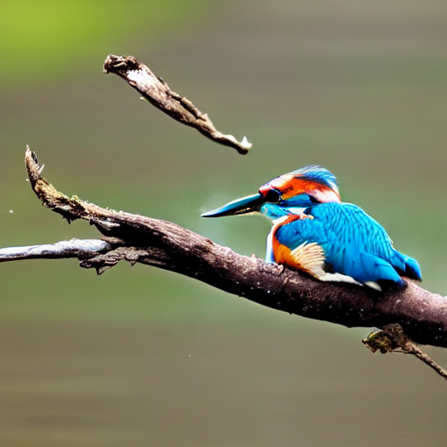

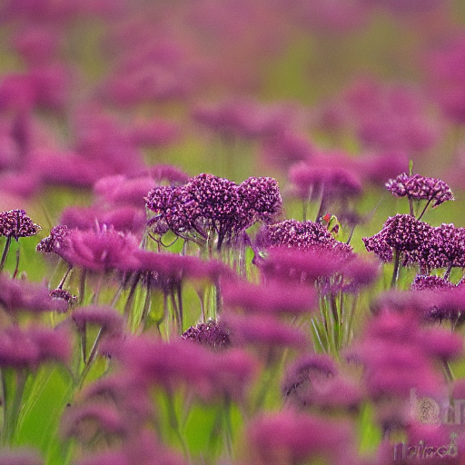
RESULTS & COMPARATIVE ANALYSIS
Model | Input → output | Observed in notebook outputs
AE | MNIST digit → reconstruction | Digit shapes kept; strokes blurred; one 4 drawn closer to a 9
VAE | Digit → reconstruction; random z → samples | Similar blur; the 2 distorted; random samples often malformed
DCGAN | Noise → digit-like image | Digit-like strokes; many artefacts; some not recognisable
Stable Diffusion | Text prompt → 512 × 512 image | Detailed, realistic scenes; minor artefacts (e.g. stray branch piece)
Fig. 1 AE: original (top) vs reconstructed (bottom)
Fig. 2 VAE: original (top) vs reconstructed (bottom)
AE train loss (MSE): 0.0895 → 0.0222
VAE train loss (BCE+KL): 248.56 → 119.69
Losses use different definitions, so they are not compared. Test MSE uses only 8 test images: not a ranking.
Prompts: tiger, kingfisher, mountain sunrise, wildflowers
Fig. 3 DCGAN samples
Fig. 4 Stable Diffusion
Page 04

Slide 5
CONCLUSION & LEARNING OUTCOMES
Model | Strength | Limitation
AE | Simple; compact latent code | Blurs details; latent space not structured for sampling
VAE | Probabilistic latent space; can sample | Blurry outputs; random samples often unclear
DCGAN | Sharp-edged digit-like samples | Artefacts after short training; training can be unstable
Stable Diffusion | Detailed, text-guided images with no training here | Heavy compute; prompt details not always followed
Key learning
Reconstruction rebuilds a given input; generation creates new images
A pretrained diffusion model gives text-conditioned detail without training
No single model wins: each suits a different goal
Study limitations
Different data and outputs (MNIST digits vs text-to-image), small subsets, 10 epochs, one run: a capability comparison, not a benchmark
Applications
AE/VAE: compression, denoising, anomaly detection. DCGAN: data augmentation. Stable Diffusion: concept art, design drafts.
Page 05

